Slide 1
BigData Hands-On Advanced Spark Java, UDF, Parquet
Esilv 2024
arnaud.nauwynck@gmail.com

Slide 2
Exercise 1 : Analyzing Parquet Files, using "parquet-cli"

Slide 3
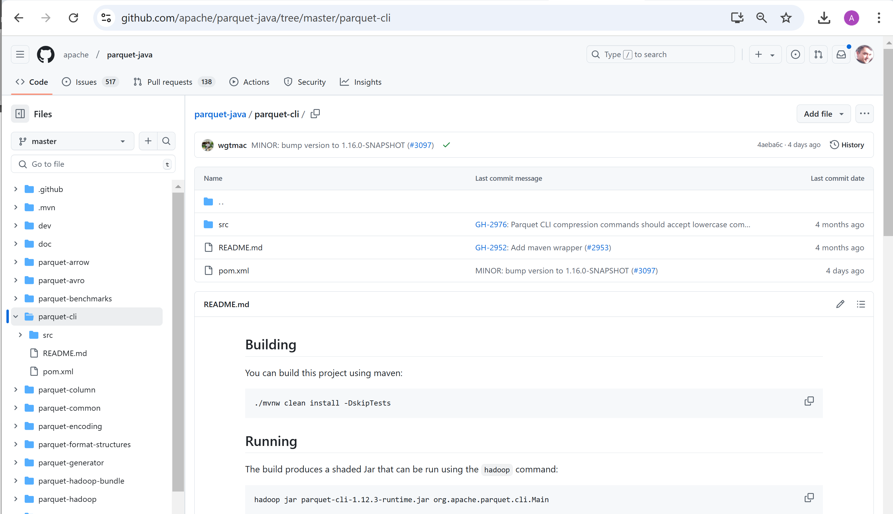
Analysing Parquet File, using "parquet-cli"

Slide 4
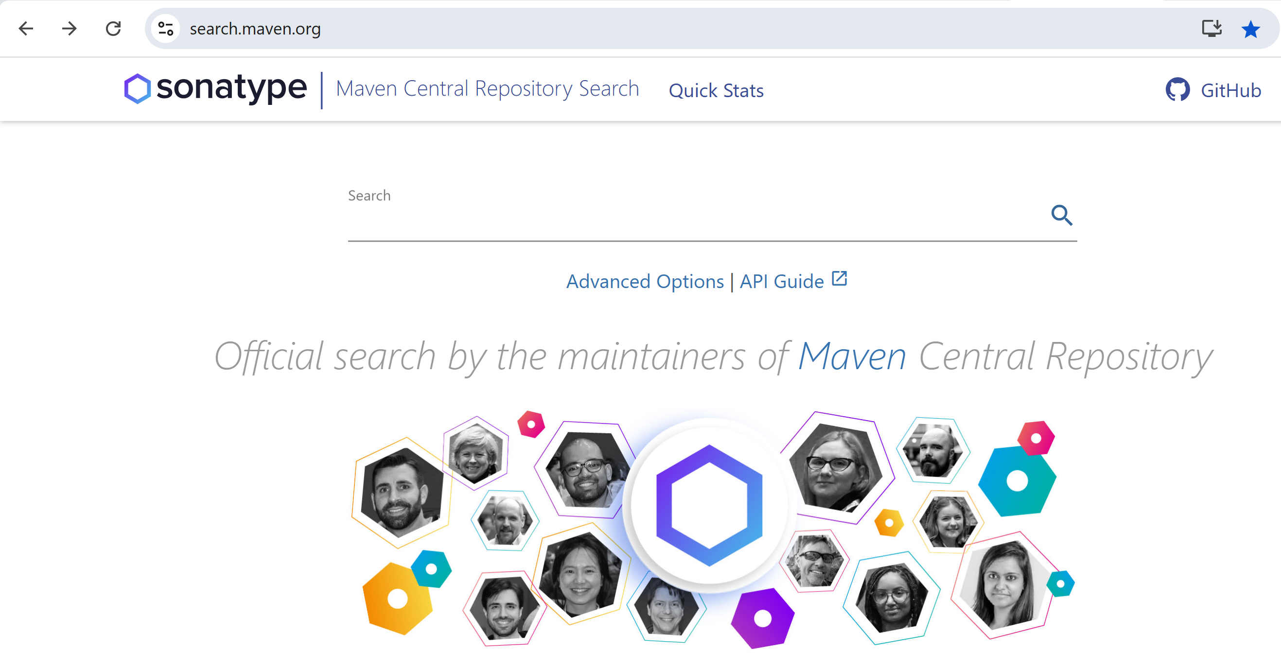
Search jar in maven repo: https://search.maven.org

Slide 5
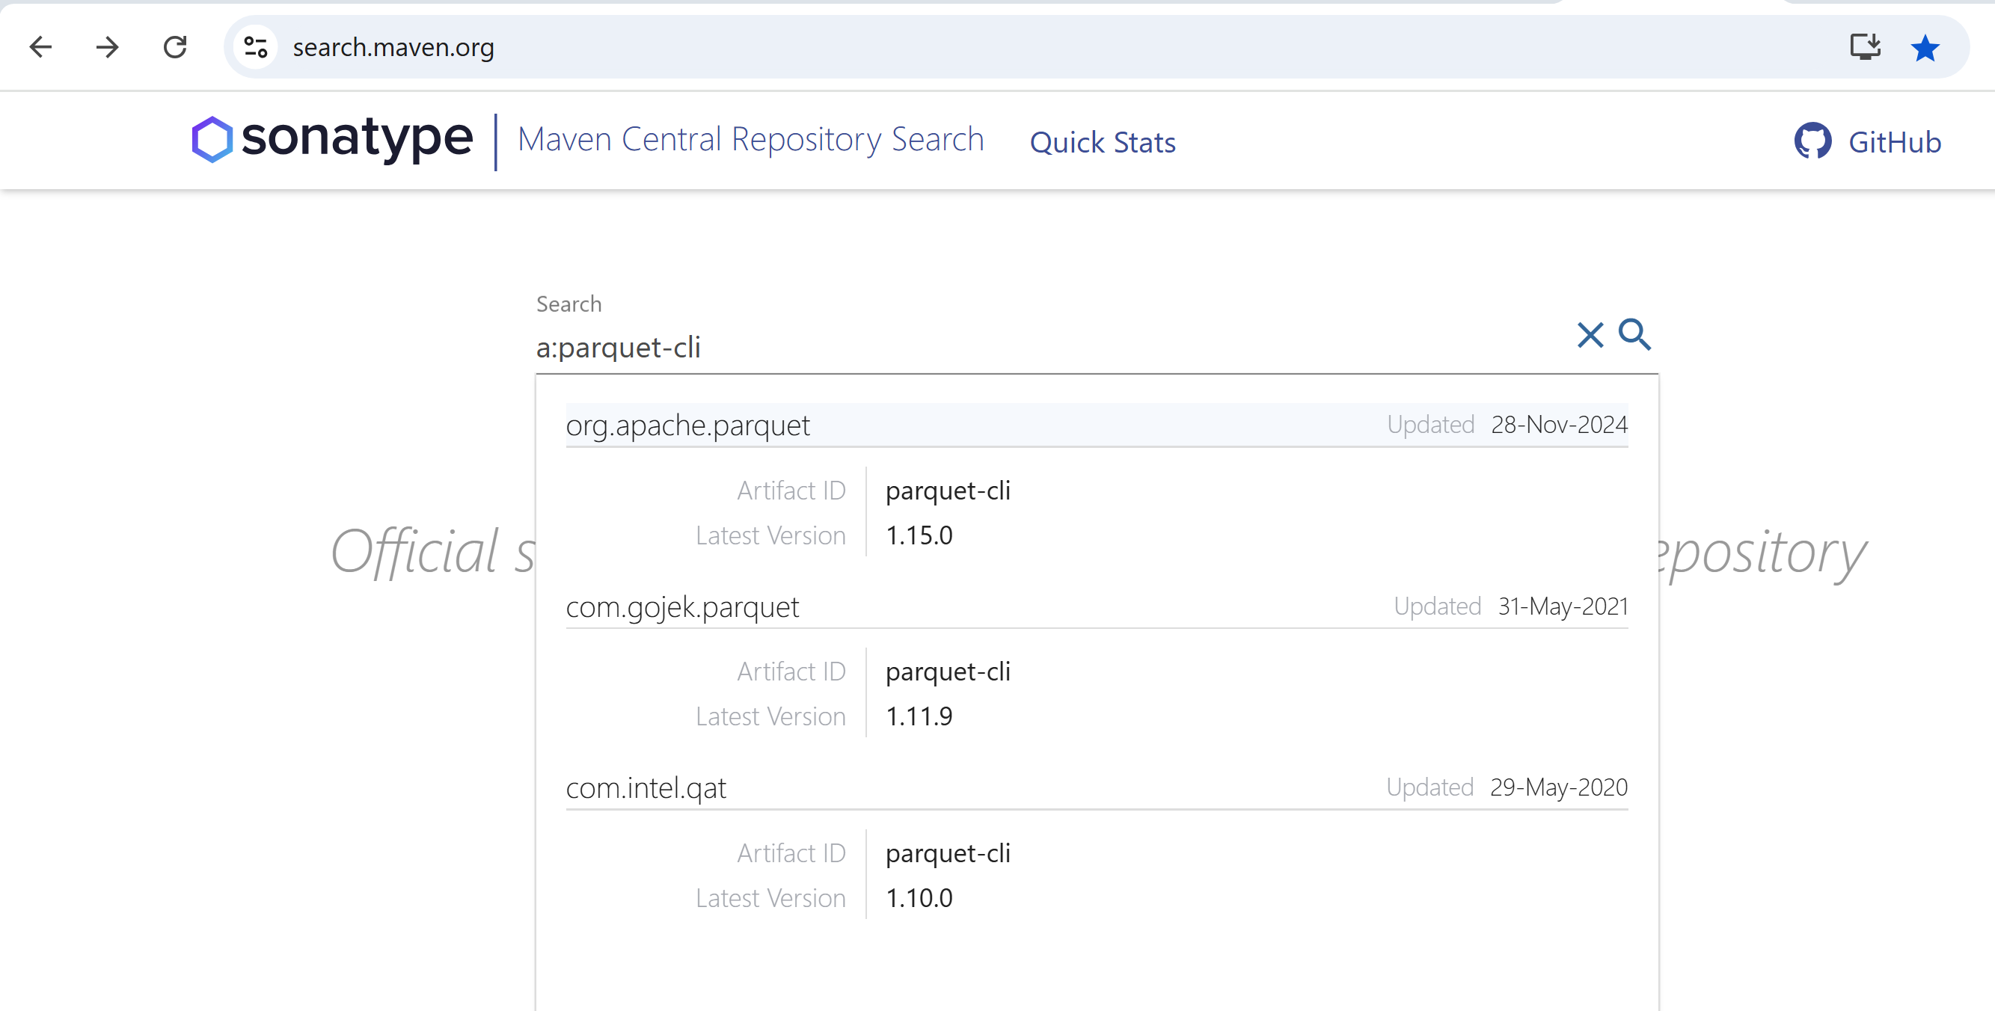
type search "a:parquet-cli" g:org.apache.parquet

Slide 6
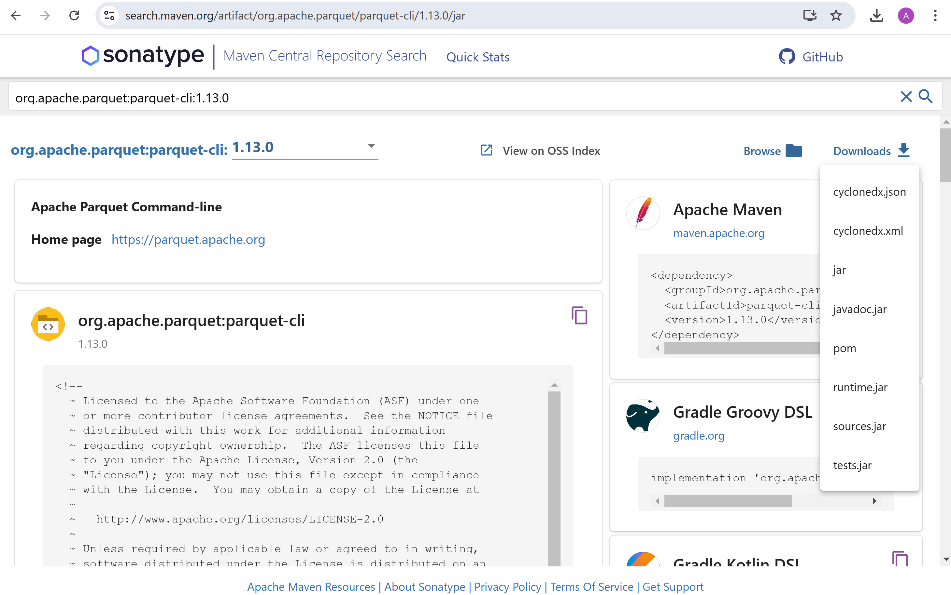
Downloading "parquet-cli" runtime.jar for same version 1.13.0 (same as spark/jars/*.jar)

Slide 7
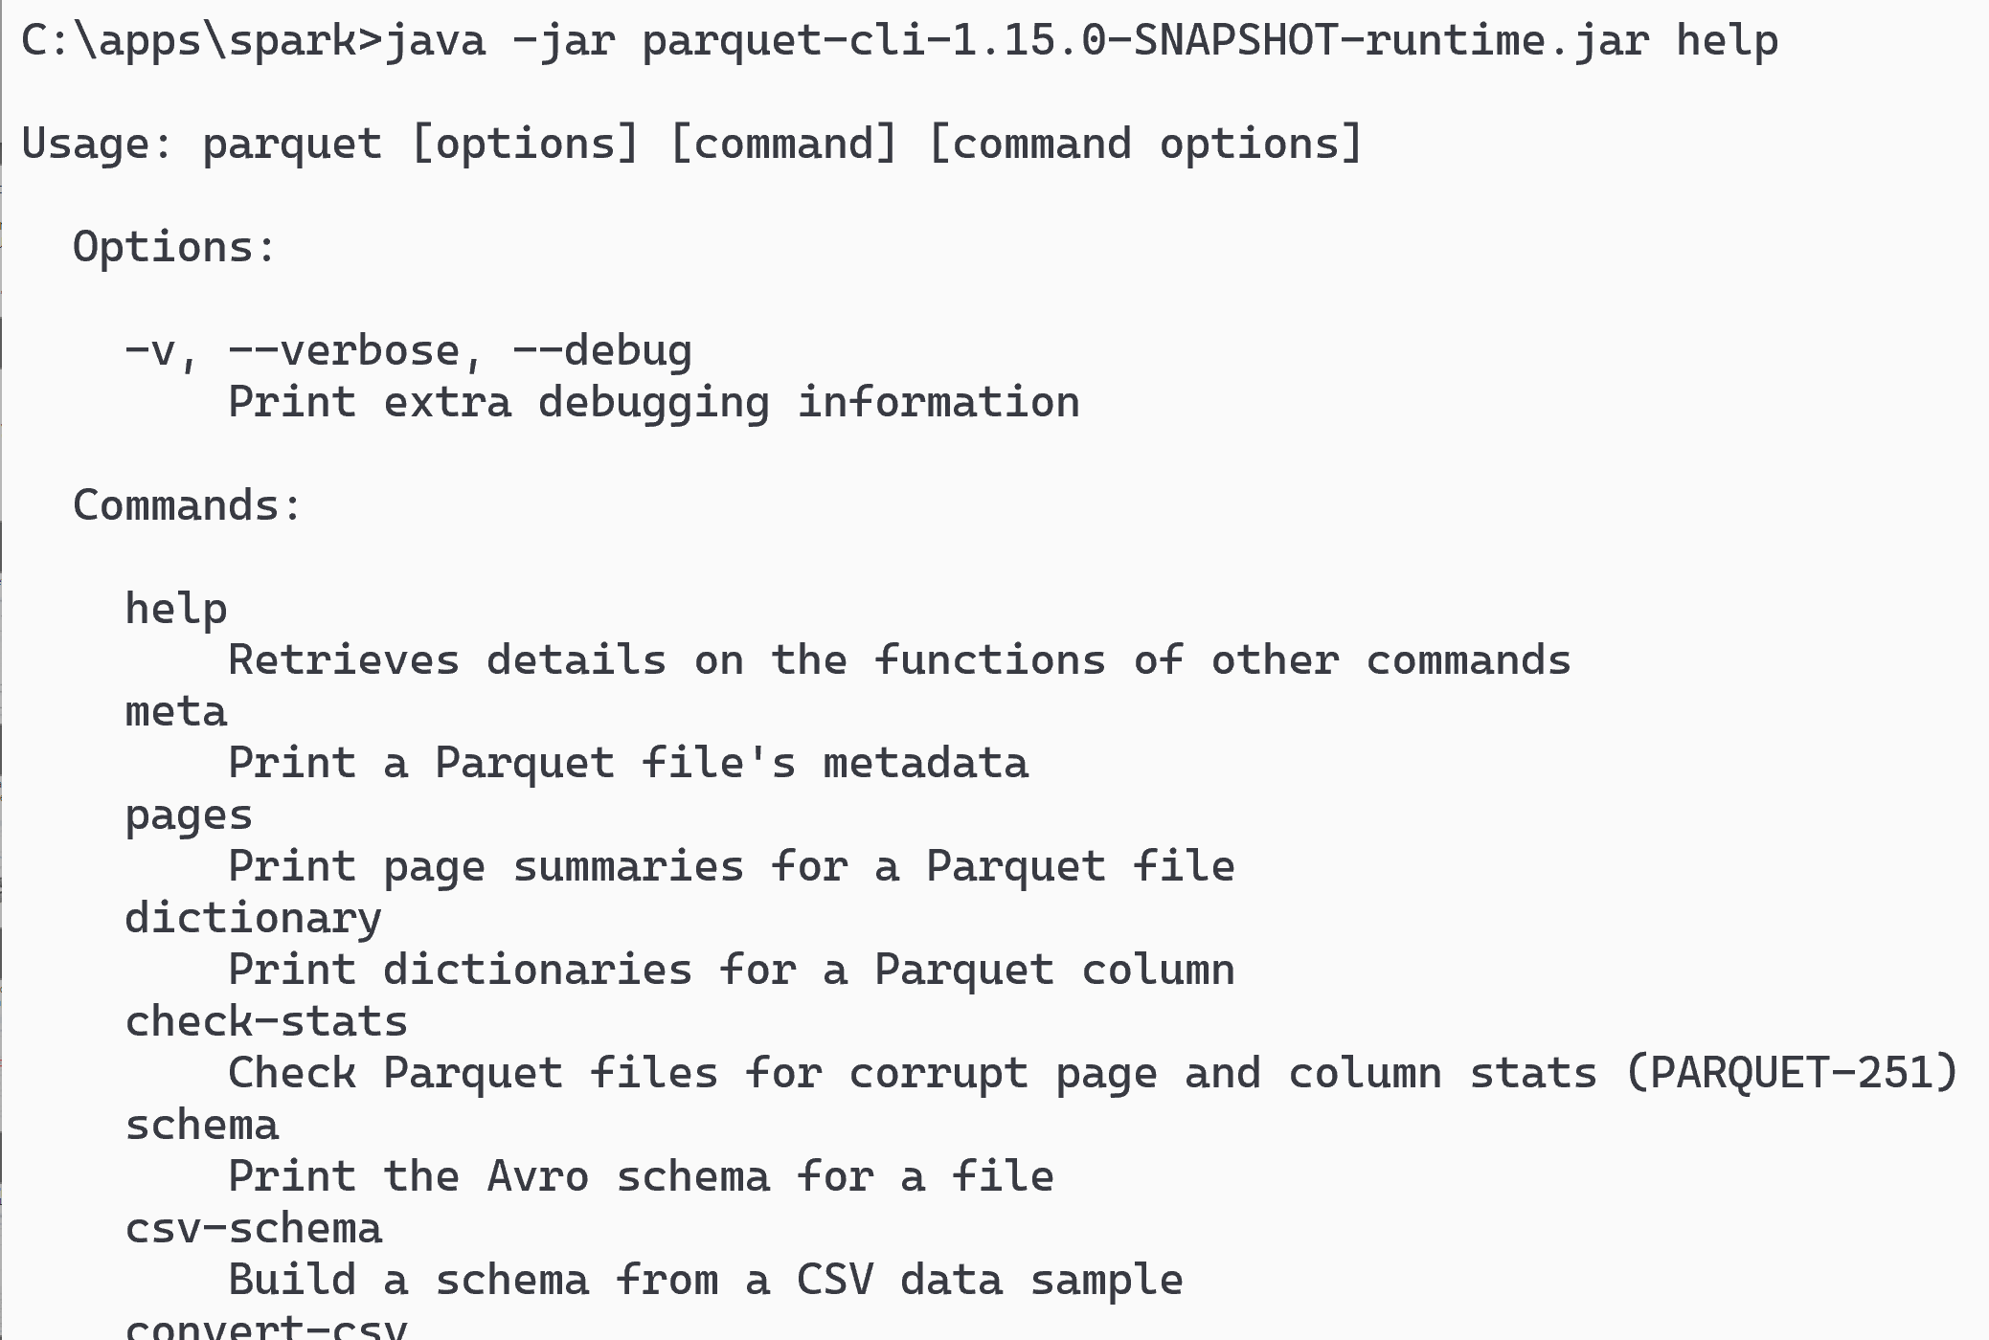
Launching parquet-cli
java -jar parquet-cli-runtime.jar help
(using shaded jar, otherwise may need to add hadoop classpath)

Slide 8
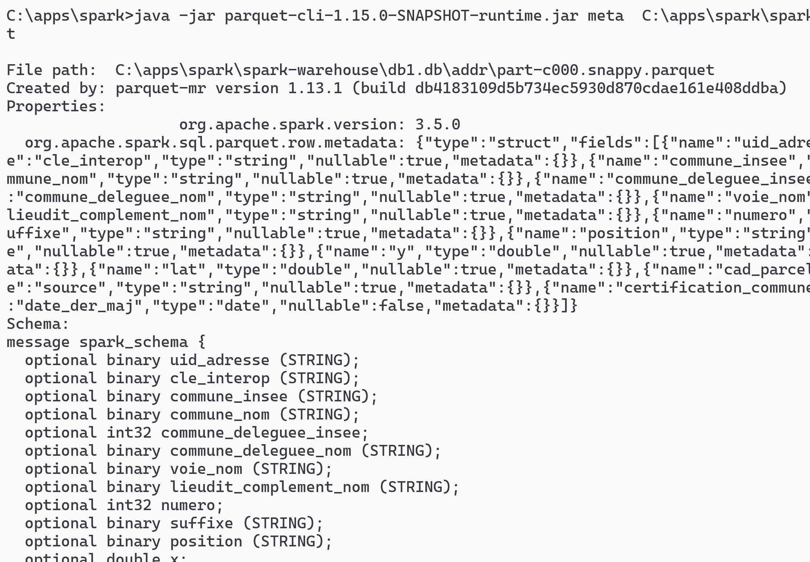
parquet-cli meta [1/2]
java -jar parquet-cli-runtime.jar meta file.parquet

Slide 9
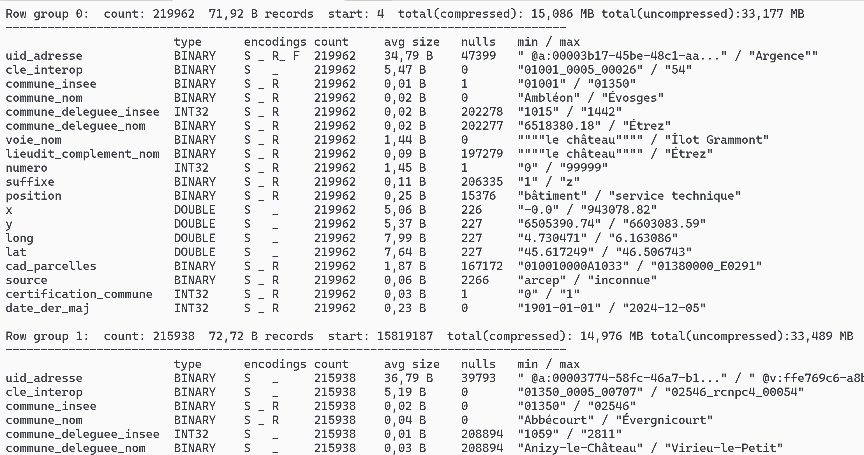
parquet-cli meta [2/2]

Slide 10
parquet-cli meta | grep "Row group"
java -jar parquet-cli-runtime.jar meta file.parquet > meta.txt
grep "Row group" meta.txt | head
Row group 0: count: 219962 71,92 B records start: 4 total(compressed): 15,086 MB total(uncompressed):33,177 MB
Row group 1: count: 215938 72,72 B records start: 15819187 total(compressed): 14,976 MB total(uncompressed):33,489 MB
Row group 2: count: 213992 73,68 B records start: 31523114 total(compressed): 15,036 MB total(uncompressed):33,821 MB
Row group 3: count: 233199 70,29 B records start: 47289138 total(compressed): 15,631 MB total(uncompressed):34,232 MB
Row group 4: count: 231558 69,04 B records start: 63679653 total(compressed): 15,246 MB total(uncompressed):33,383 MB
Row group 5: count: 219962 74,89 B records start: 79665824 total(compressed): 15,710 MB total(uncompressed):34,531 MB
Row group 6: count: 218409 73,91 B records start: 96138854 total(compressed): 15,394 MB total(uncompressed):33,957 MB
Row group 7: count: 199907 75,02 B records start: 112281114 total(compressed): 14,301 MB total(uncompressed):31,914 MB
Row group 8: count: 218409 69,87 B records start: 127277278 total(compressed): 14,552 MB total(uncompressed):34,174 MB
Row group 9: count: 272568 65,80 B records start: 142536439 total(compressed): 17,104 MB total(uncompressed):35,616 MB
grep "Row group" meta.txt | tail
Row group 108: count: 252150 64,55 B records start: 1719335249 total(compressed): 15,522 MB total(uncompressed):34,027 MB
Row group 109: count: 215240 71,68 B records start: 1735611436 total(compressed): 14,715 MB total(uncompressed):34,014 MB
Row group 110: count: 219962 68,48 B records start: 1751040857 total(compressed): 14,365 MB total(uncompressed):32,978 MB
Row group 111: count: 219962 68,18 B records start: 1766103960 total(compressed): 14,302 MB total(uncompressed):32,914 MB
Row group 112: count: 234887 64,52 B records start: 1781100645 total(compressed): 14,454 MB total(uncompressed):33,355 MB
Row group 113: count: 236624 66,44 B records start: 1796256273 total(compressed): 14,993 MB total(uncompressed):37,495 MB
Row group 114: count: 234063 65,95 B records start: 1811977242 total(compressed): 14,722 MB total(uncompressed):33,626 MB
Row group 115: count: 213992 73,42 B records start: 1827414634 total(compressed): 14,983 MB total(uncompressed):34,526 MB
Row group 116: count: 230100 69,58 B records start: 1843125866 total(compressed): 15,269 MB total(uncompressed):36,039 MB
Row group 117: count: 152925 67,36 B records start: 1859136956 total(compressed): 9,823 MB total(uncompressed):26,622 MB

Slide 11
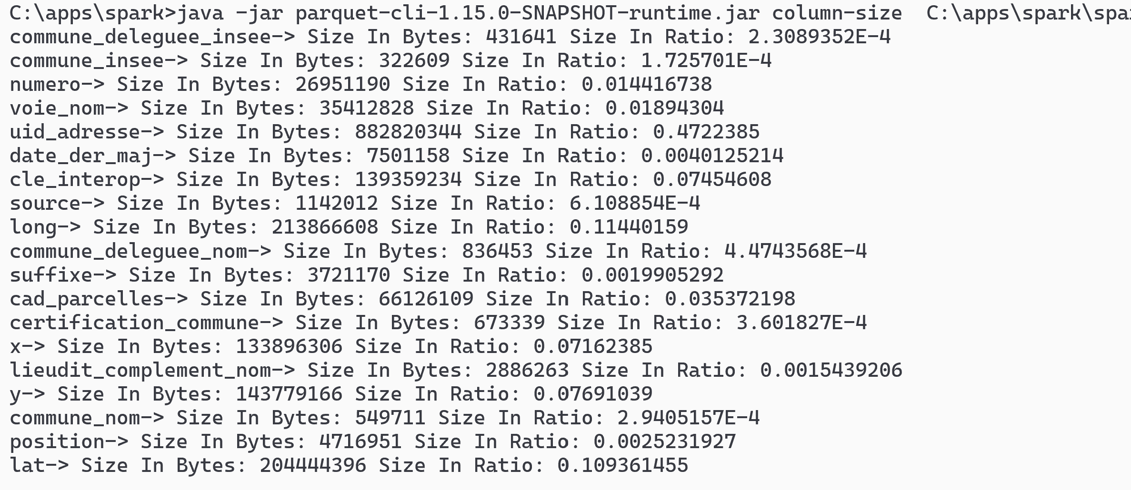
parquet-cli column-size
java -jar parquet-cli-runtime.jar column-size file.parquet

Slide 12
Column Sizes ... sorting
cat column-size | sed 's/-> Size In Bytes//g' | sed 's/ Size In Ratio//g' | sed 's/: /;/g' > column-size.csv
Column | Size | Ratio | Size in Mo
uid_adresse | 882820344 | 47,22% | 841,9
long | 213866608 | 11,44% | 204,0
lat | 204444396 | 10,94% | 195,0
y | 143779166 | 7,69% | 137,1
cle_interop | 139359234 | 7,45% | 132,9
x | 133896306 | 7,16% | 127,7
cad_parcelles | 66126109 | 3,54% | 63,1
voie_nom | 35412828 | 1,89% | 33,8
numero | 26951190 | 1,44% | 25,7
date_der_maj | 7501158 | 0,40% | 7,2
position | 4716951 | 0,25% | 4,5
suffixe | 3721170 | 0,20% | 3,5
lieudit_complement_nom | 2886263 | 0,15% | 2,8
source | 1142012 | 0,06% | 1,1
commune_deleguee_nom | 836453 | 0,04% | 0,8
certification_commune | 673339 | 0,04% | 0,6
commune_nom | 549711 | 0,03% | 0,5
commune_deleguee_insee | 431641 | 0,02% | 0,4
commune_insee | 322609 | 0,02% | 0,3
total | 1869437488 | 100,00% | 1782,8

Slide 13
Parquet Column Sizes Summary
zipcode ("commun_insee") : 0.3 Mo
+
city name ("commun_nom") : 0.5 Mo
+
street name ("voie_nom") : 33.8 Mo
+
numero : 25.7 Mo
=> 60 Mega (3% of file)
+ longitude, latitude : 204 Mo + 195 Mo
=> 459 Mo
most of the column size is
uid_address : 840 Mo (47.2%)
+
x, y ... redundant with longitude,lattitude
+
cle_interop : 132 Mo (7.4%)
... we will see parquet "column-pruning" in action : skipping unnecessary columns !

Slide 14
Exercise 2,3: Spark SQL <-> Java with UDF Function

Slide 15
Exercise 2
The city name "Laval" written in reversed order is still "laval"
(ignoring case) This is a palindrome How many French cities are like this?

Slide 16
Hint : Use Dataset .map() and .filter() and String .toLowerCase() and .reverse()
If you forgot to do ".toLowerCase()" => there would be only 1 City, named "Y"
in fact, there are 21
can you find them all ?
afa
callac
cazac
erre
esse
laval
noyon
...

Slide 17
Exercise Setup
spark.sql("SELECT DISTINCT commune_nom, commune_insee FROM db1.addr")
.write.format("parquet").saveAsTable("db1.city")
spark.sql("select count(*) from db1.city").show() // => 34986
spark.sql("SELECT distinct commune_nom FROM db1.city")
.write.format("parquet").saveAsTable("db1.city_name")
spark.sql("select count(*) from city_name").show() // => 32735 ... almost 2000 duplicate city name in France !
OK, this is NOT BigData... we could "collectAsList()" and perform directly in scala

Slide 18
HINT
val palindromes = spark.sql("select commune_nom from db1.city")
.map(row => row.getString(0).toLowerCase())
.filter(x => x.reverse == x)
palindromes.count()
palindromes.show()

Slide 19
"String.reverse()" is Java built-in => redo with SQL built-in
Reapeat exercise in SQL (not using Spark Dataset API),
spark.sql("""
select commune_nom from db1.city
WHERE reverse(lower(commune_nom))=lower(commune_nom)
""").show()
Too easy again...

Slide 20
Using SQL and User-Defined Function "UDF"
.. Reapeat without using built-in Sql "REVERSE",
by defining your own UDF function "isPalindrome(text)"
SELECT * FROM db1.city
WHERE isPalindrome(lower(commune_nom))
complete code: spark.udf.register("isPalindrome", (s: String) => ....)

Slide 21
HINT
spark.udf.register("isPalindrome", (s: String) => s != null && s == s.reverse)
spark.sql("select commune_nom from db1.city WHERE isPalindrome(lower(commune_nom))").show()

Slide 22
Exercise 3
City names
"Sancerre" and "Nanterre"
have only 2 letters difference.
The postman could do mistakes...
How many cities are error-prone like this.
What is the city with the most numerous errors, for 1 letter of difference?

Slide 23
What is an "Edit Distance" ?
how many letters differ between "paris" and "parés"
=> Response : 1 (change of 1 letter "i" -> "é")
how many letters differ between "paris" and "pris"
=> Response : 1 (deletion of 1 letter "a")
Calculating "changed" letters only is trivial (but not in SQL).
How do you compute efficiently distances for "deletion" + "change" + "insertion" ?
... even in Java, it need special algorithm

Slide 24
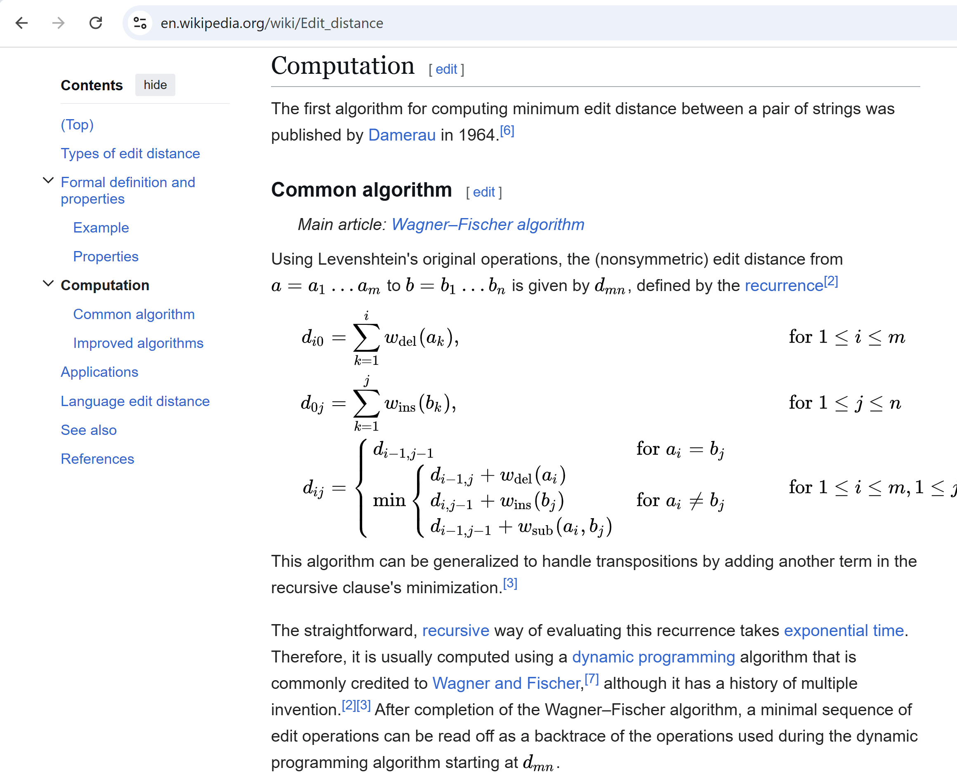
Edit Distance with Dynamic Programming Algorithm

Slide 25
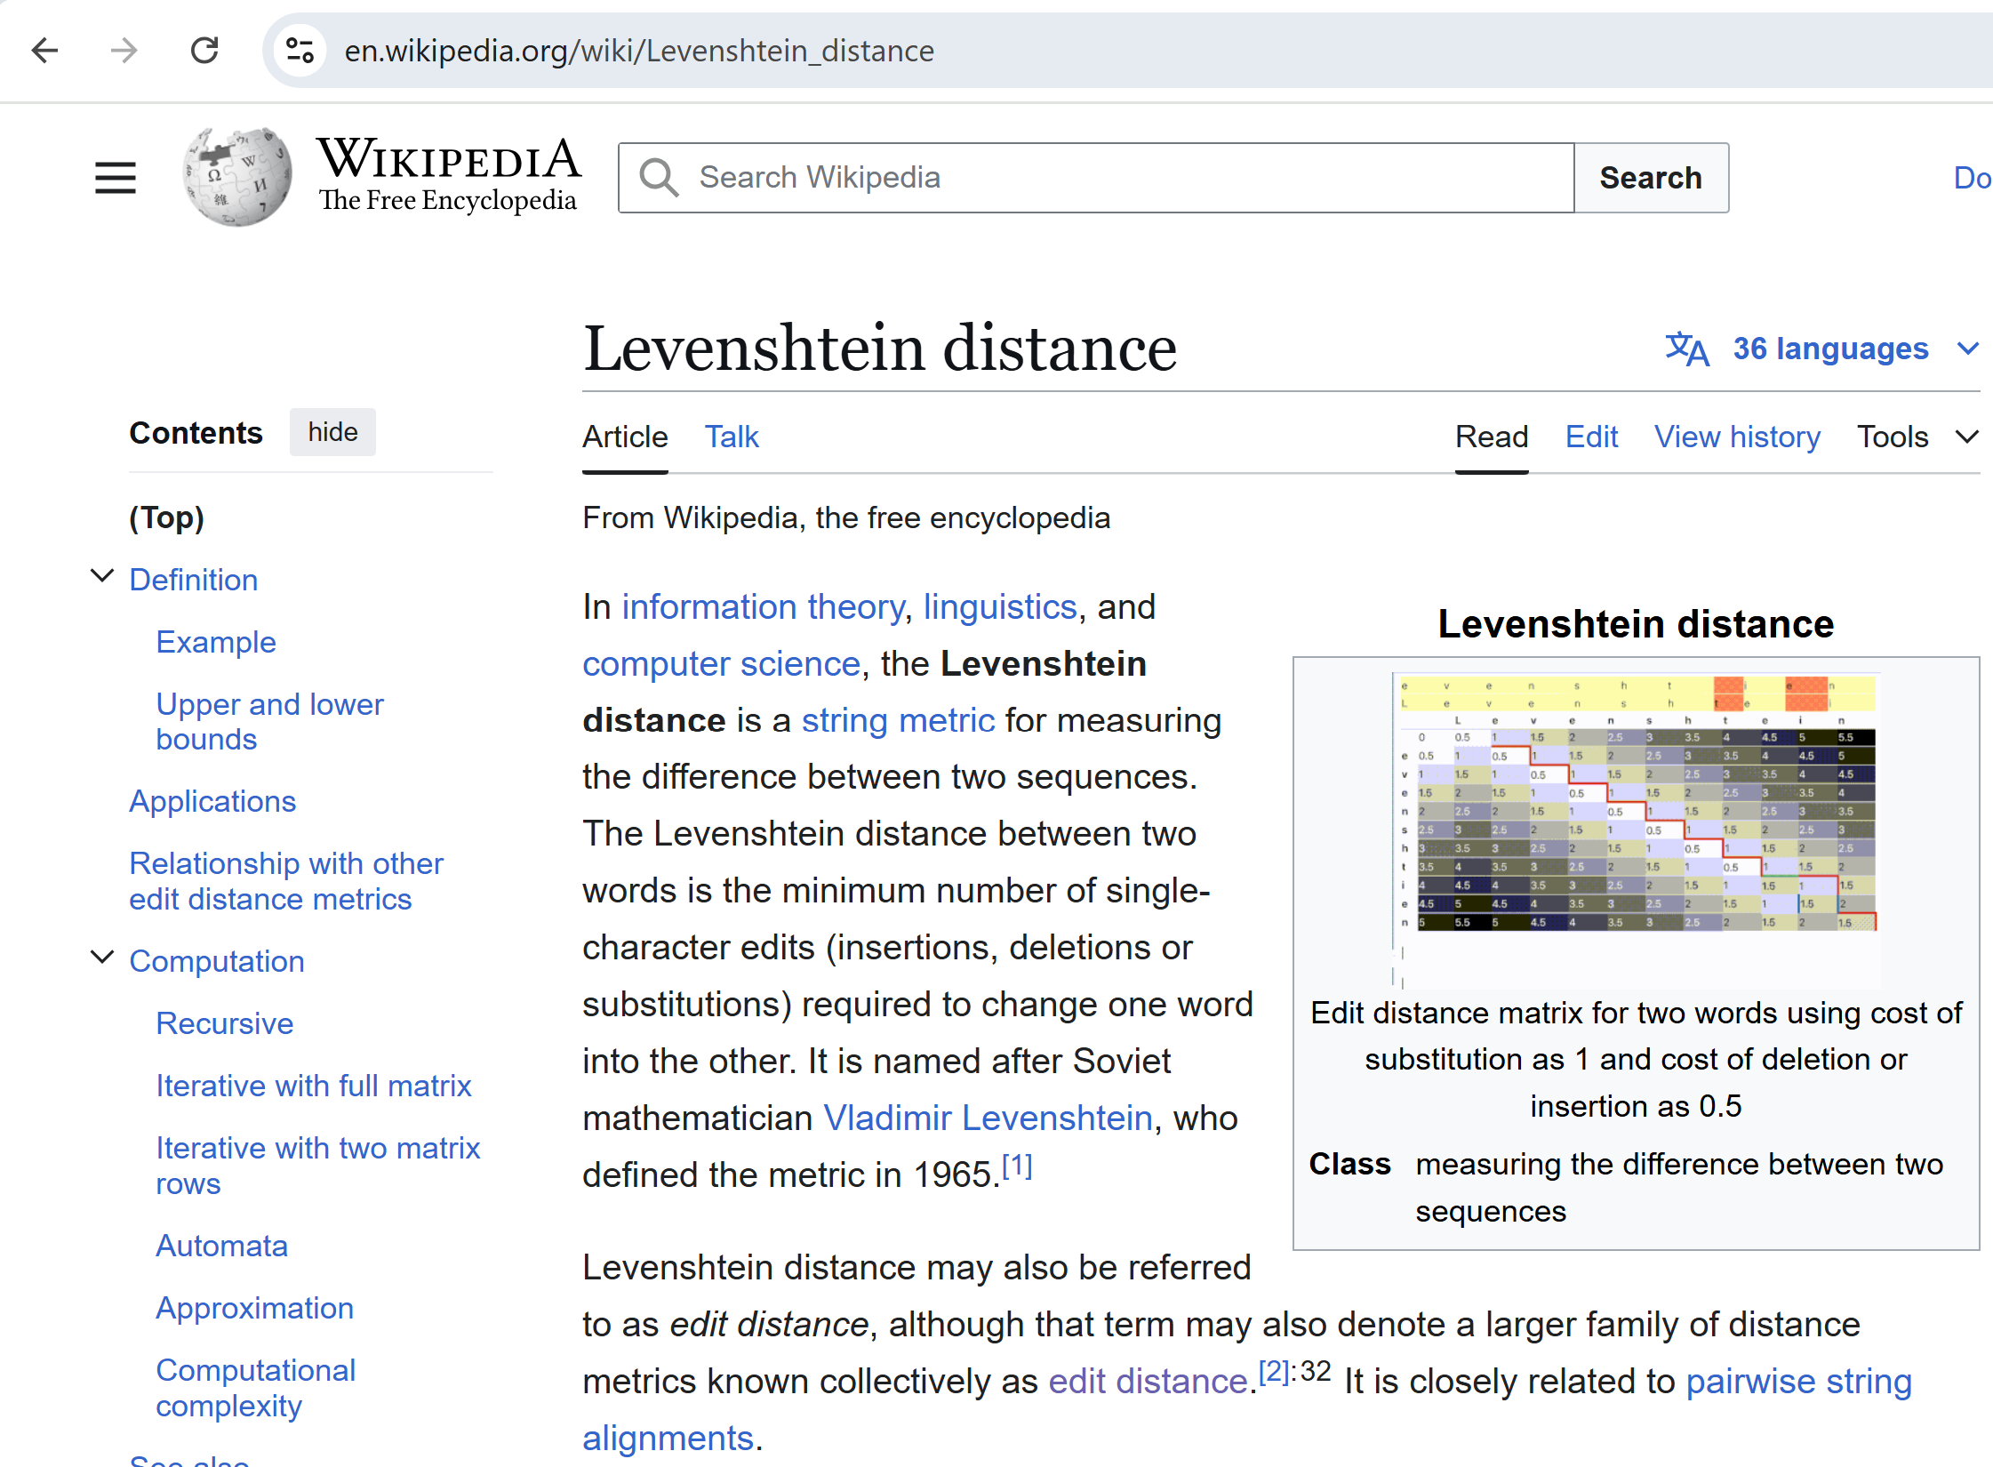
Levenstein Distance

Slide 26
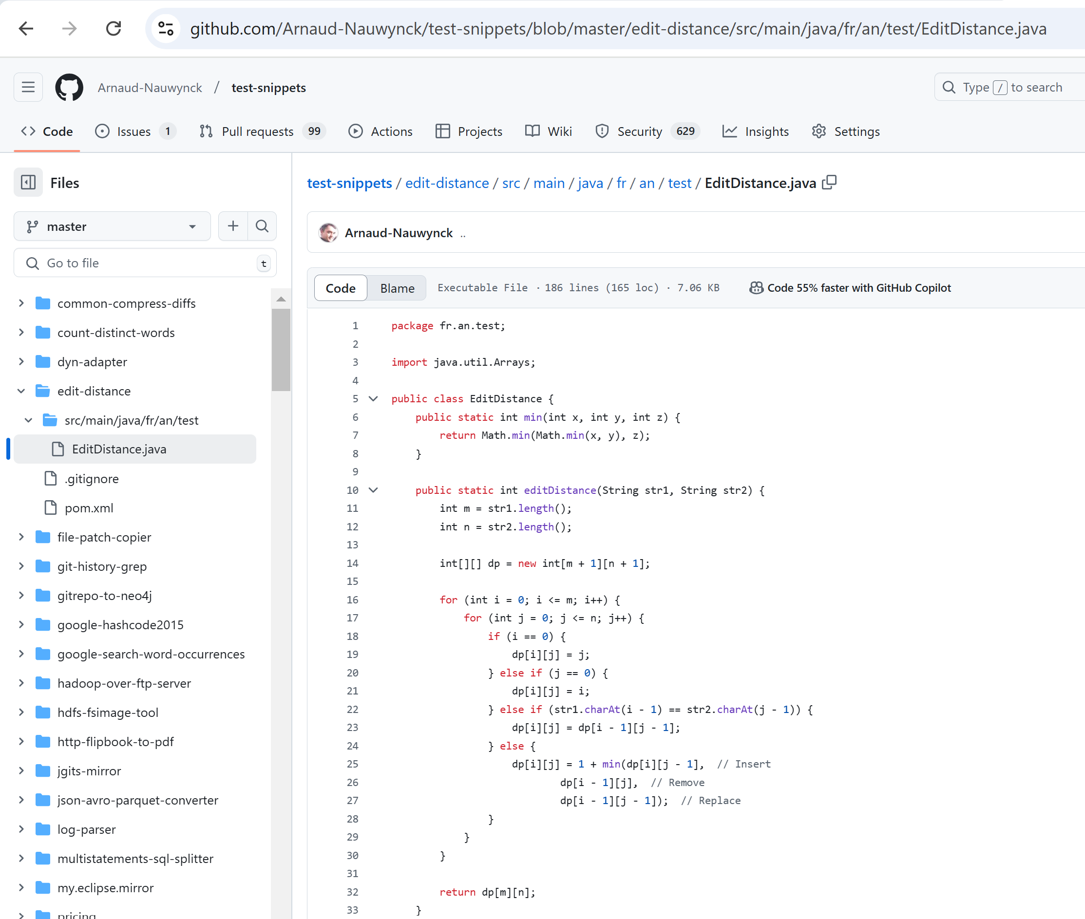
EditDistance.java Implementation
source code (extracted from apache Commons Lang)
https://github.com/Arnaud-Nauwynck/test-snippets/blob/master/edit-distance/src/main/java/fr/an/test/EditDistance.java

Slide 27
Download jar (or rebuild "mvn package") + relaunch "spark-shell --jars your.jar"
spark-shell --driver-memory=8g --jars edit-distance.jar
or using full path
spark-shell --driver-memory=8g --jars file:///c:/apps/spark/edit-distance.jar
or simply copy file in ${SPARK_HOME}/jars/

Slide 28
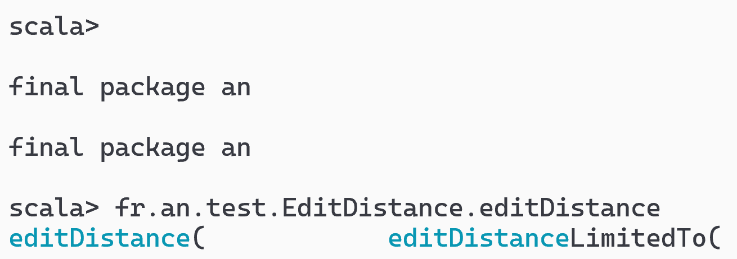
Test Class is available in spark-shell scala>
Test in interactive shell that you have <TAB><TAB> Auto-completion
on "fr."
=> autocomplete to package "fr.an"
..
<TAB><TAB>
=> autocomplete to package "fr.an" ... then to class then to methods

Slide 29
Test Java methods (in scala)
fr.an.test.EditDistance.editDistance("paris", "pris")
// 1
// the variant "LimitedTo" stop computing for a given threshold, and return it as maximum diff
fr.an.test.EditDistance.editDistanceLimitedTo("paris", "pris", 5)
// 1
fr.an.test.EditDistance.editDistanceLimitedTo("paris", "prisées", 10)
// 4
fr.an.test.EditDistance.editDistanceLimitedTo("paris", "prisées", 3)
// 3 ... real diff was 4, but result limited to 3

Slide 30
Define UDF functions, Test in SQL
spark.udf.register("editDistance", udf( (str1: String, str2: String) => fr.an.test.EditDistance.editDistance(str1, str2 )));
spark.udf.register("editDistanceLimitedTo", udf( (str1: String, str2: String, m: Int) => fr.an.test.EditDistance.editDistanceLimitedTo(str1, str2, m)));
spark.sql("select editDistance('paris', 'pris')").show()
// 1
spark.sql("select editDistanceLimitedTo('paris', 'prisées', 3)").show()
// 3

Slide 31
callUDF() : call using Dataset Column API
val ds2 = ds.withColumn("dist_to_paris", callUDF("editDistance", lit("paris"), $"commune_nom") )
scala> ds2.show(5, false)
+------------------------+-----------------+
|commune_nom |dist_to_paris|
+------------------------+-----------------+
|Frans |4 |
|Coulonges-Cohan|14 |
|Grisolles |7 |
|Leury |5 |
|Deux-Chaises |10 |
+-----------------------+-----------------+
NOTE: calling explicitly in java
import org.apache.spark.sql.functions;
functions.callUDF("editDistance", functions.lit("paris"), col(commune_nom"))

Slide 32
Recap Exercise... cross join city1, city2 restrict with city1 < city2 eval d=distanceLimitedTo (.. 2) filter d<2
what is the algorithm complexity for N cities ?
spark.sql("select count(*) from db1.city").show() // 34986
using distinct name? 32735
34986 * 34986 / 2 = 612010098 = 612 Millions of city pairs to eval
and each computation, this may take long => so restrict to maximum 2 differences,
we will consider only diff=1 (<2)
( On Intel Core i7, it takes ~3 minutes )

Slide 33
Dataset Cross Cities with distance<2
val crossDs = spark.sql("""
SELECT distinct c1.commune_nom as c1_nom, c2.commune_nom as c2_nom
FROM db1.city_name c1
CROSS JOIN db1.city_name c2
WHERE c1.commune_nom < c2.commune_nom
""")
// repartition does NOT work here !
val crossDist = crossDs.repartition(16).withColumn("d", callUDF("editDistanceLimitedTo", crossDs("c1_nom"), crossDs("c2_nom"), lit(2))).filter($"d" < 2).cache()
crossDist.show(10, false) // <=== take long ~3 minutes !!!

Slide 34
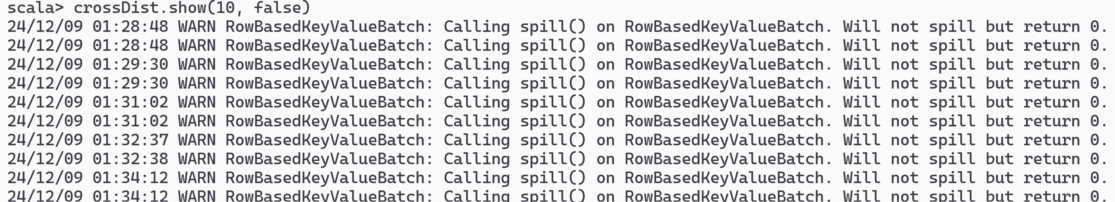
Spill to Disk ... use --driver-memory=8g

Slide 35
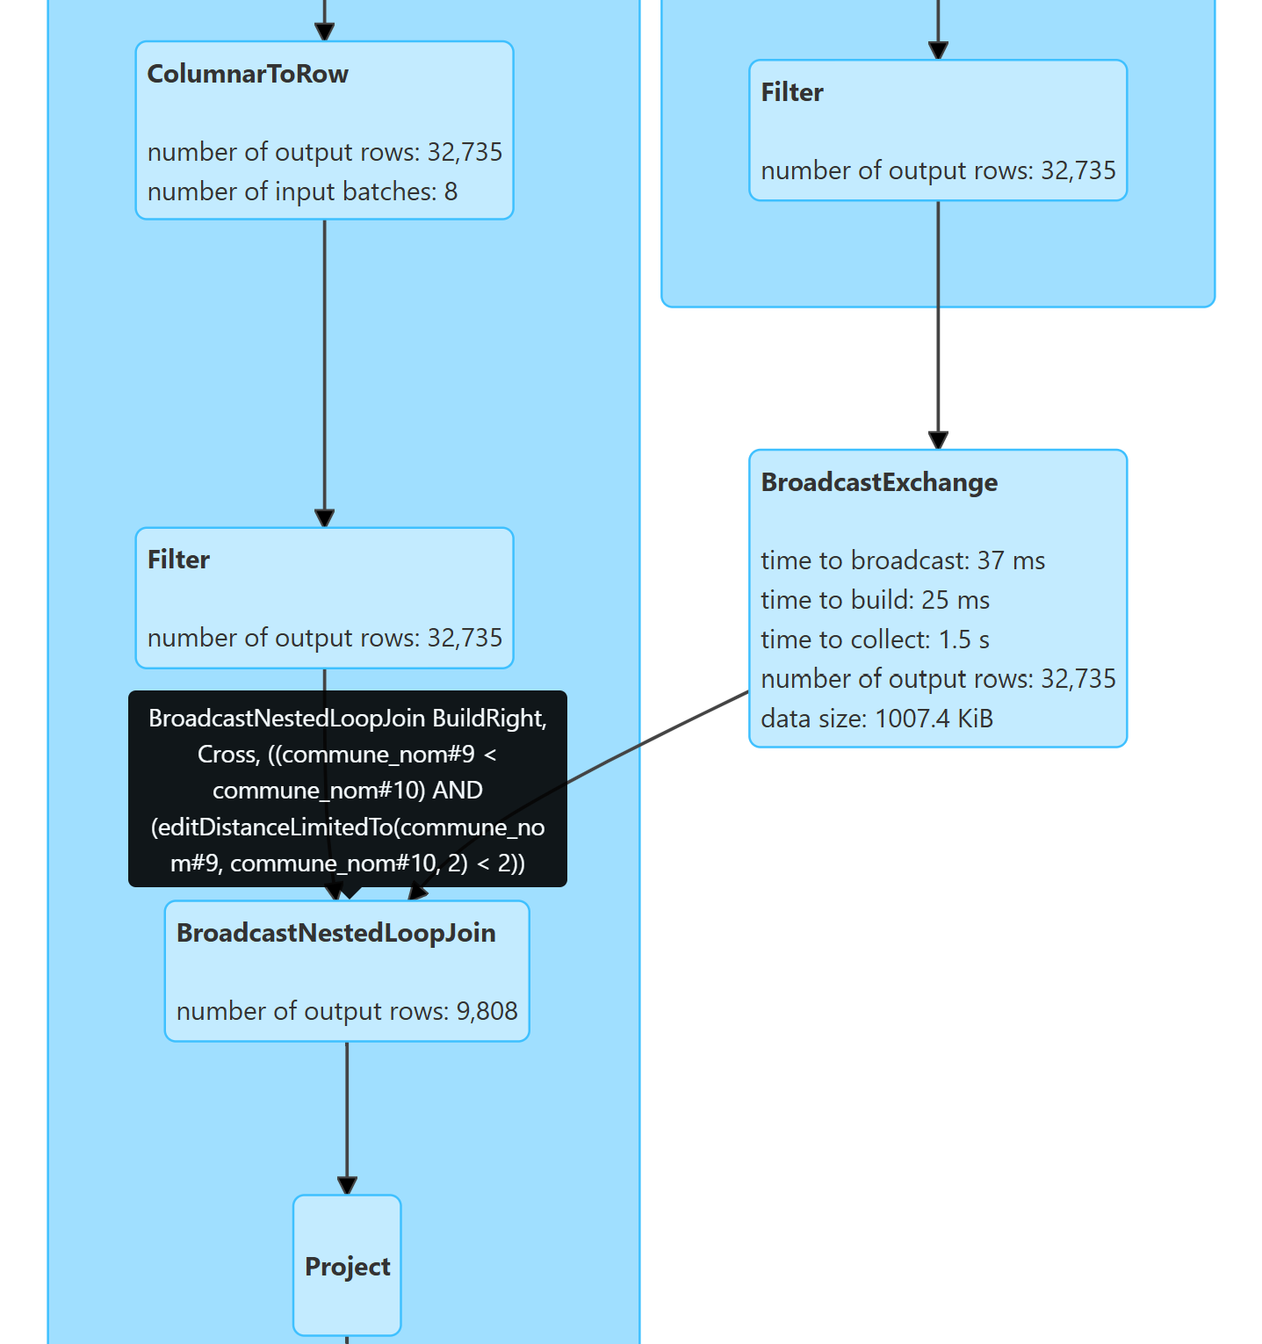
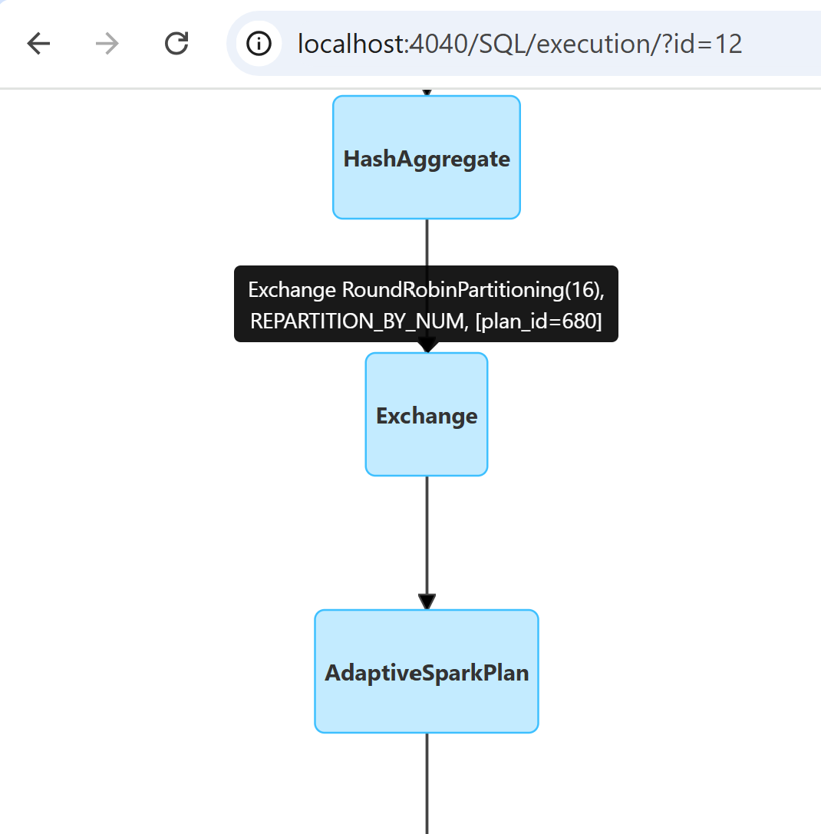
.repartition(16) IGNORED !! => only using 1 CPU
push down
in broadcast join !
or even AQE
after

Slide 36
Cross City Pairs with Distance=1
scala> crossDist.show(10, false)
+---------------------------+---------------------------+---+
|c1_nom |c2_nom |d |
+---------------------------+---------------------------+---+
|Auge |Augy |1 |
|Many |Mary |1 |
|Lunan |Lunay |1 |
|Caunay |Launay |1 |
|Ballons |Baâlons |1 |
|Sassay |Sassy |1 |
|Marseille 2e Arrondissement|Marseille 9e Arrondissement|1 |
|Saisy |Saizy |1 |
|Amécourt |Imécourt |1 |
|Audon |Auxon |1 |
+---------------------------+---------------------------+---+
only showing top 10 rows
scala> crossDist.count()
val res4: Long = 9808

Slide 37
Find the Cities having the most similarities Can you find this ?
+---------------------+-------+
| c1_nom|count|
+---------------------+-------+
| Bailly | 13|
| Cailly | 12|
| Bessac | 10|
| Aron | 10|
| Bay | 10|
|Paris 10e Arro...| 10|
| Coux | 10|
| Maray | 10|
| Aigny | 10|
| Lailly | 10|
+---------------------+-------+
only showing top 10 rows

Slide 38
HINT
crossDist.groupBy("c1_nom").count().orderBy(desc("count")).show(10)
WARNING: when forgetting to use "distinct commune_nom"
(cities with same name, but different zipCode)
+-------------+-----+
| c1_nom|count|
+-------------+-----+
| Caumont| 56|
| Ferrières| 55|
| Mons| 49|
| Celles| 44|
| Brion| 42|
| Bailly| 40|
| Bannes| 40|
| Fons| 39|
| Marsac| 36|
| Salles| 35|
+-------------+-----+
only showing top 10 rows

Slide 39
13 Cities with Distance=1 to "Bailly"
spark.sql("""select c1_nom, d from (select c1.commune_nom as c1_nom, editDistanceLimitedTo(c1.commune_nom, "Bailly", 2) as d from db1.city_name c1 where c1.commune_nom <> "Bailly") where d < 2 ORDER BY d """).show(50);
+-------+---+
| c1_nom| d|
+-------+---+
| Vailly| 1|
| Nailly| 1|
| Sailly| 1|
| Jailly| 1|
| Mailly| 1|
| Lailly| 1|
| Cailly| 1|
| Billy| 1|
| Pailly| 1|
| Tailly| 1|
| Wailly| 1|
| Failly| 1|
|Batilly| 1|
|Bacilly| 1|
+-------+---+

Slide 40
12 Cities with Distance=1 to "Bessac"
spark.sql("""select c1_nom, d from (select c1.commune_nom as c1_nom, editDistanceLimitedTo(c1.commune_nom, "Bessac", 2) as d from db1.city_name c1 where c1.commune_nom <> "Bessac") where d < 2 ORDER BY d """).show(50);
+-------+---+
| c1_nom| d|
+-------+---+
| Pessac| 1|
| Bessay| 1|
| Messac| 1|
| Bessan| 1|
| Bassac| 1|
|Beyssac| 1|
|Blessac| 1|
| Cessac| 1|
| Bessas| 1|
| Lessac| 1|
| Bussac| 1|
+-------+---+

